Slide 1
Revision of yesterday
Quickwrite:
What are Corresponding angles?
Notes:
hook

Slide 2
Lesson objective
By the end of this lesson you will be able to;
Identify alternate angles
Solve problems involving Alternate angles
Notes:
Lesson

Slide 3
24
7
30
Date
Alternate angles
EQ – How can we use alternate angles?
What are Alternate angles?
When a line cuts through two parallel lines, Alternate angles are formed by a Z shape.
Alternate angles are equal.
5
Notes:
Lesson objective (EQ)

Slide 4
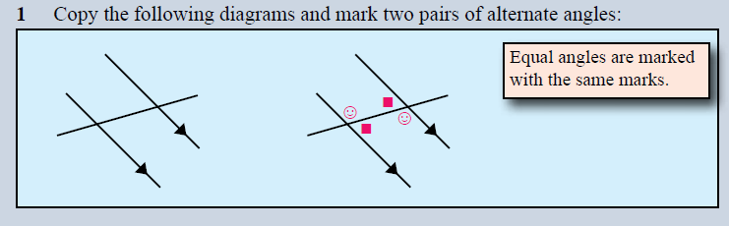
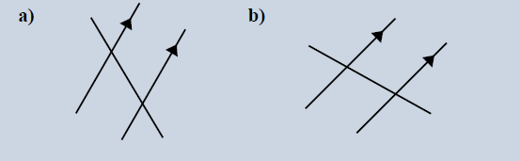
Copy and mark the pairs of Alternate angles
Notes:
Check for understanding

Slide 5
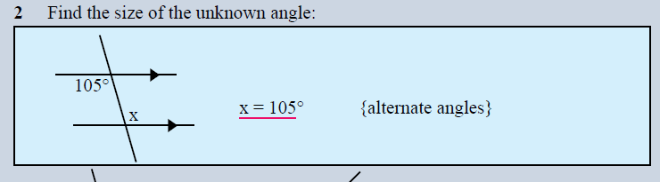
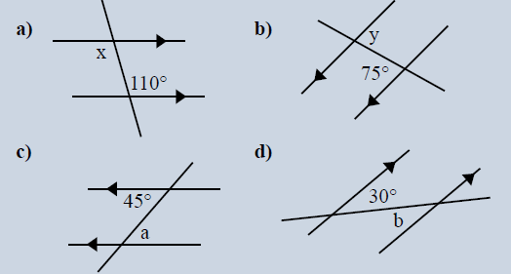
Find the size of the unknown angles
Notes:
Guided practice

Slide 6
Practice Sheet
Complete the worksheet
Notes:
Independent practice

